Slide 1
ND0
TRPL

Slide 2
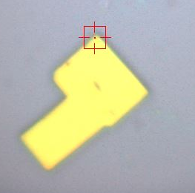
pt1
1
2
3
7
5
8
6
4
20µm

Slide 3
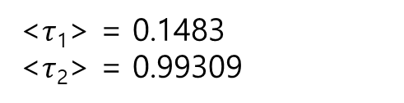
pt1
<$τ$₁> = 0.1483
<$τ$₂> = 0.99309

Slide 4
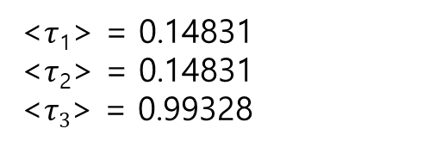
pt1
<$τ$₁> = 0.14831
<$τ$₂> = 0.14831
<$τ3$> = 0.99328

Slide 5
pt2

Slide 6
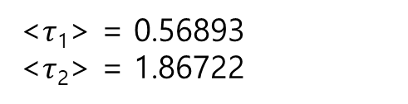
pt2
<$τ$₁> = 0.56893
<$τ$₂> = 1.86722

Slide 7
pt2

Slide 8
pt3

Slide 9
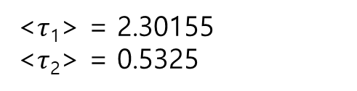
pt3
<$τ$₁> = 2.30155
<$τ$₂> = 0.5325

Slide 10
pt4

Slide 11
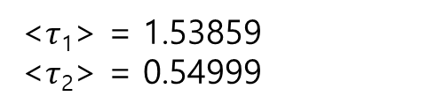
pt4
<$τ$₁> = 1.53859
<$τ$₂> = 0.54999

Slide 12
pt5

Slide 13
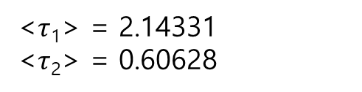
pt5
<$τ$₁> = 2.14331
<$τ$₂> = 0.60628

Slide 14
pt6

Slide 15
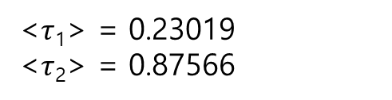
pt6
<$τ$₁> = 0.23019
<$τ$₂> = 0.87566

Slide 16
pt7

Slide 17
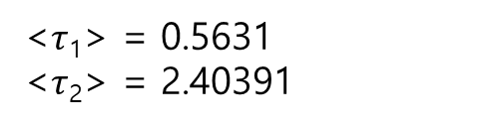
pt7
<$τ$₁> = 0.5631
<$τ$₂> = 2.40391

Slide 18
pt8

Slide 19
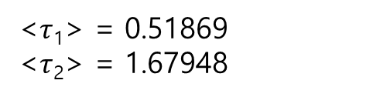
pt8
<$τ$₁> = 0.51869
<$τ$₂> = 1.67948

